Slide 1
DHINESH M 821721104016 B.E Computer Science & Engineering – IIIyear Sir Issac Newton College Of Engineering And Technology

Slide 2
PROJECT TITLE
Storke Prediction Using CNN

Slide 3


AGENDA
Creating a stroke prediction system using Convolutional Neural Networks (CNNs) can be a fascinating project with potentially life-saving implications. Here's an agenda outlining the steps you might take:
Understanding Stroke
Data Collection and Preprocessing
Feature Engineering
Designing the CNN Architecture
Model TrainingEvaluation and Validation:
Fine-tuning and Optimization
Interpretation and Deployment
Ethical Considerations
Documentation and Communication
Future Work
3/21/2024 Annual Review

Slide 4

PROBLEM STATEMENT
The problem revolves around predicting the likelihood of an individual experiencing a stroke based on medical imaging data such as brain MRI or CT scans. Given a dataset of labeled images, the task is to train a CNN model to accurately classify these images into two classes: stroke-positive and stroke-negative. The model should be able to generalize well to unseen data and provide reliable predictions for early stroke detection.
3/21/2024 Annual Review

Slide 5

PROJECT OVERVIEW
Objective: The main goal of this project is to develop a predictive model using Convolutional Neural Networks (CNNs) to predict the likelihood of stroke occurrence based on medical imaging data.
Dataset: The project utilizes a dataset consisting of medical images, such as MRI or CT scans, along with associated patient information including demographics, medical history, and lifestyle factors. This dataset is crucial for training the CNN model to recognize patterns indicative of stroke.
Convolutional Neural Networks (CNNs): CNNs are a type of deep learning algorithm commonly used for image recognition tasks. They are particularly effective for analyzing visual data due to their ability to automatically learn and extract features from images.
3/21/2024 Annual Review

Slide 6

WHO ARE THE END USERS?
In stroke prediction using CNN (Convolutional Neural Networks), the end users typically include
healthcare professionals
doctors
Nurses
Researchers
patients
3/21/2024 Annual Review

Slide 7

YOUR SOLUTION AND ITS VALUE PROPOSITION
Our solution for stroke prediction utilizes Convolutional Neural Networks (CNNs), a type of deep learning algorithm that has shown remarkable performance in image recognition tasks, and we adapt it for medical imaging analysis related to strokes. The CNN takes as input medical imaging data, such as MRI or CT scans of the brain, and learns to identify patterns indicative of potential stroke occurrences.
3/21/2024 Annual Review

Slide 8
MODELLING
Stroke prediction using Convolutional Neural Networks (CNN) involves leveraging advanced machine learning techniques to analyze medical images such as MRI scans, CT scans, or even ultrasound images to predict the likelihood of an individual experiencing a stroke. Here are some key points about modelling in stroke prediction using CNN
Data Preprocessing
Convolutional Neural Networks (CNN)
Architecture Design
Validation and Testing
Interpretability
Deployment
Overall, CNNs offer a promising approach for stroke prediction by efficiently extracting features from medical images, but careful model development, validation, and interpretation are essential to ensure accurate and reliable predictions.
3/21/2024 Annual Review
8

Slide 9
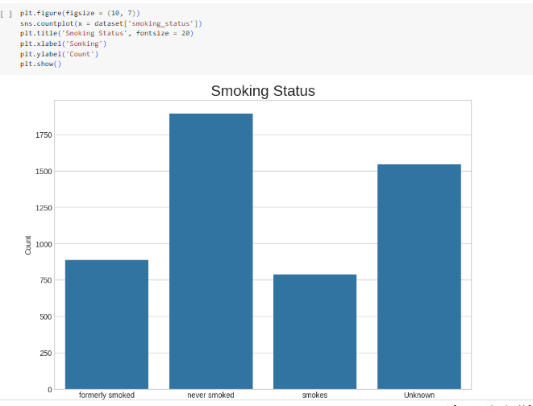
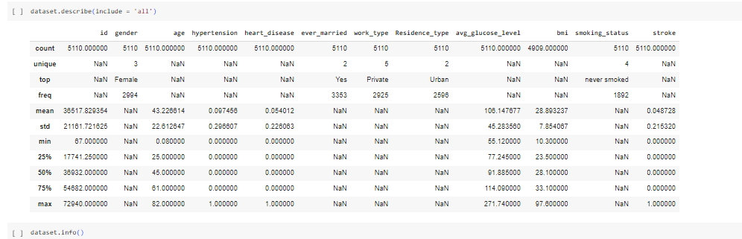
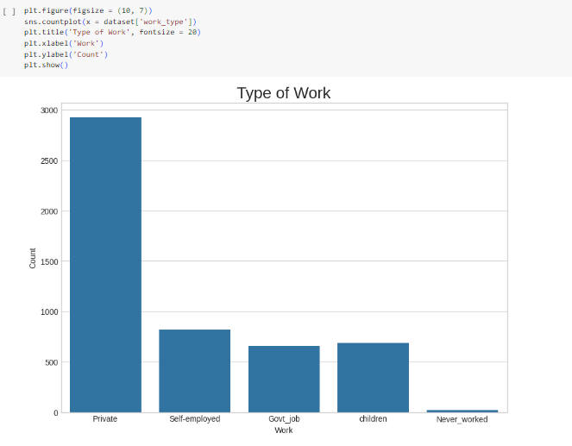
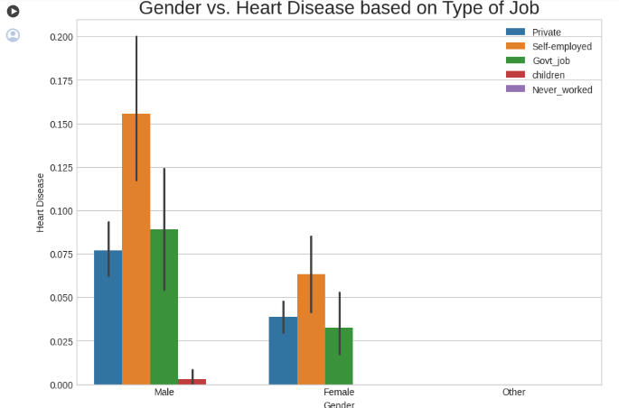
RESULTS
Demo Link
3/21/2024 Annual Review
9

